Slide 1
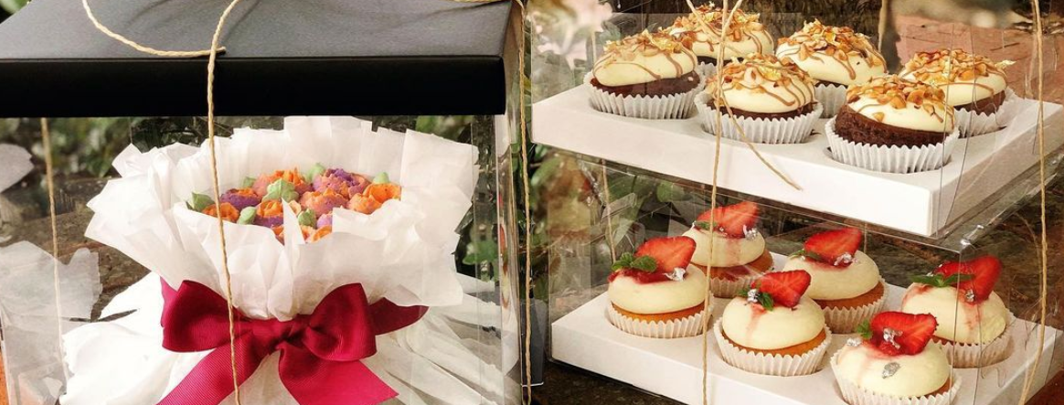
darker

Slide 2
lighter

